Slide 1

CLUB DISPUTE
RESOLUTION
WORKSHOP
Fair processes, confident decisions

Slide 2
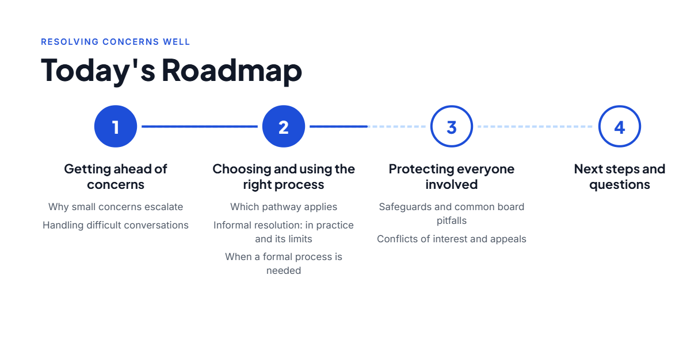
CLUB DISPUTE RESOLUTION WORKSHOP
2

Slide 3
CLUB DISPUTE RESOLUTION WORKSHOP
Why we are here
PREVENT ESCALATION
RESOLVE FAIRLY
Recognize concerns early and respond constructively.
Choose the right process and apply appropriate safeguards.
KNOW WHEN TO ASK
Understand the support available to your club.
Goal: less heavy lifting for clubs, more consistency and fairer outcomes.

Slide 4
CLUB DISPUTE RESOLUTION WORKSHOP
Why complaints escalate
NOT HEARD
UNCLEAR ROLES
No clear response or acknowledgement
Expectations or authority misunderstood
PERCEIVED BIAS
DECIDED TOO SOON
Relationships or interests unaddressed
Perspectives not considered
4

Slide 5
CLUB DISPUTE RESOLUTION WORKSHOP
A practical approach to difficult conversations
LISTEN
CLARIFY
Understand what happened and what matters to the person.
Explain the rule, role or decision-making authority.
EXPLORE
CONFIRM
Invite perspectives and consider workable solutions.
Agree on next steps, a contact and follow-up.
Use a neutral person where appropriate. Informal discussions do not impose findings or discipline.

Slide 6
CLUB DISPUTE RESOLUTION WORKSHOP
Start with the right pathway
GENERAL DISPUTE
MALTREATMENT
Program, policy or operational concern
Applicable Safe Sport mechanism
OTHER PROCESS
Employment, elections, bylaws, specific appeals
7

Slide 7
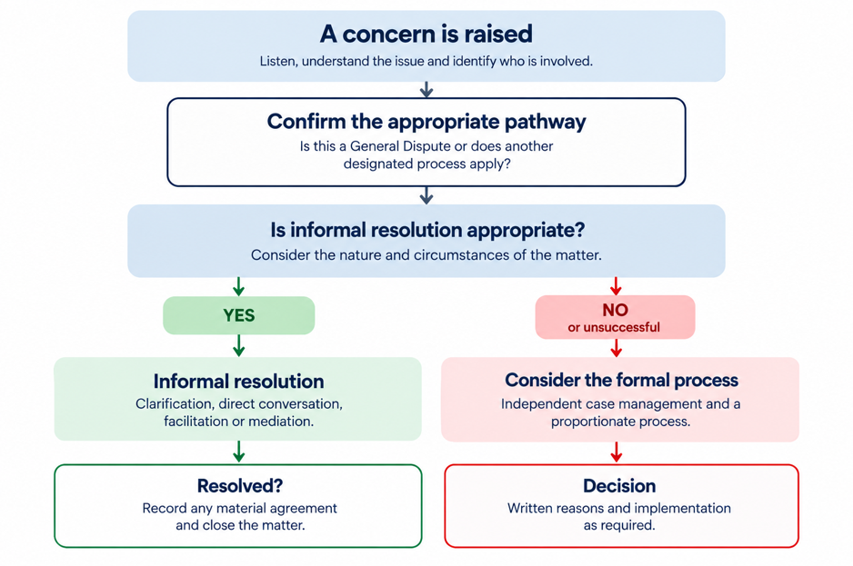
CLUB DISPUTE RESOLUTION WORKSHOP
How this works for a Club/School
Informal Resolution is encouraged where appropriate, but is not mandatory. Matters requiring another designated process must be referred accordingly.
10

Slide 8
CLUB DISPUTE RESOLUTION WORKSHOP
Why we have a common Dispute Resolution Policy
CONSISTENCY
EARLY RESOLUTION
One shared approach for clubs and the Section.
Address concerns collaboratively where appropriate.
RIGHT PATHWAY
FORMAL SAFEGUARDS
Refer Safe Sport and other designated matters to the correct process.
A fair, proportionate process when informal resolution is insufficient.

Slide 9
CLUB DISPUTE RESOLUTION WORKSHOP
Informal Resolution: six practical steps
1 UNDERSTAND
2 CLARIFY
3 COMMUNICATE
Identify the issue, people involved, outcome sought and correct pathway.
Review relevant policies, decisions, roles and expectations.
Invite constructive conversation and explore solutions.
4 NEUTRAL HELP
5 DOCUMENT
6 REASSESS
Consider a conflict-free facilitator or mediator.
Record material agreements, responsibilities and follow-up.
If unresolved or inappropriate, consider the formal or designated process.
Flexible steps—not a mandatory sequence. Participation and agreement remain voluntary.

Slide 10
CLUB DISPUTE RESOLUTION WORKSHOP
Informal Resolution: what it can—and cannot—do
Informal resolution CAN:
Informal resolution CANNOT:
• Clarify expectations and misunderstandings
• Require someone to agree or settle
• Support voluntary practical solutions
• Impose binding findings or discipline
• Include neutral or culturally appropriate assistance
• Replace a designated reporting process
Privacy, impartiality and an opportunity to be heard still matter.

Slide 11
CLUB DISPUTE RESOLUTION WORKSHOP
When should we consider a Formal Process?
UNRESOLVED
BINDING DECISION
A reasonable informal attempt has not resolved the matter.
Disputed facts or responsibility need a binding determination.
SIGNIFICANT CONSEQUENCES
FAIRNESS CONCERNS
Discipline or a significant non-consensual restriction is being considered.
Conflicts, power imbalances or other circumstances require formal safeguards.

Slide 12
CLUB DISPUTE RESOLUTION WORKSHOP
Who administers the Formal Process?
CLUB ADMINISTRATION
INDEPENDENT SUPPORT
A club ordinarily administers its own dispute when it can do so fairly, independently and effectively.
The club arranges independent assistance where needed, including a Case Manager for a Formal Process.
SECTION INVOLVEMENT
FORMAL PROCESS & SAFEGUARDS
The Section may arrange administration in defined circumstances, such as conflicts, multiple clubs or lack of fair local capacity.
Independent Case Manager → proportionate process → fair opportunity to respond → written decision if required.

Slide 13
CLUB DISPUTE RESOLUTION WORKSHOP
What outcomes are possible?
CLARIFY
Education, guidance, expectations
CORRECT
AFTER THE OUTCOME
• Implement decisions
• Share only what is necessary
• Protect privacy
• Keep appropriate records
Action plans and policy compliance
RESTORE OR SET CONDITIONS
Participation, roles and proportionate restrictions
FOLLOW THROUGH
Monitoring and implementation

Slide 14
CLUB DISPUTE RESOLUTION WORKSHOP
Appeals: an important distinction
NOT A REHEARING
WHEN CAN YOU APPEAL?
Disagreement alone is not an appeal
Only when an applicable policy, bylaw, agreement or law allows it.
DEFINED GROUNDS
Applicable grounds and timelines govern

Slide 15
CLUB DISPUTE RESOLUTION WORKSHOP
Procedural fairness: what does it mean?
NOTICE
RESPONSE
Know the issue and material information
Meaningful opportunity to be heard
IMPARTIALITY
REASONS
Conflict-free decision-making
Understand the decision and why

Slide 16
CLUB DISPUTE RESOLUTION WORKSHOP
Common skating-club pitfalls
ROLE OVERLAP
One person receives, investigates and decides
PRE-JUDGEMENT
The board reaches conclusions before hearing perspectives
UNDISCLOSED CONFLICTS
Personal relationships or conflicts go undisclosed
OVER-SHARING
Sensitive information is shared too widely

Slide 17
CLUB DISPUTE RESOLUTION WORKSHOP
Conflict of interest: Identify, Disclose, Assess, Recuse & Record
FINANCIAL
PERSONAL
Contracts, fees and payments
Family and close relationships
PROFESSIONAL
PERCEPTION
Coaching and volunteer roles
Could impartiality reasonably be questioned?

Slide 18
CLUB DISPUTE RESOLUTION WORKSHOP
Handling sensitive board matters
IDENTIFY & DISCLOSE
Recognize potential conflicts and disclose them before discussion.
ASSESS & STEP ASIDE
Assess the conflict; recuse the affected person where required.
RECORD
Document decisions without unnecessary personal details
PROTECT
Use in-camera discussion appropriately, not to avoid fairness

Slide 19
CLUB DISPUTE RESOLUTION WORKSHOP
What happens next?
BEFORE LAUNCH
Final approval, tools and clear instructions
FOR CLUBS
Identify an intake contact and review current practices
SECTION SUPPORT
Guidance, resources and implementation assistance

Slide 20
CLUB DISPUTE RESOLUTION WORKSHOP
Final check-in: how did we do?
POLL — Rate each statement from 1 to 5
The timing and duration worked well.
The topics were relevant to my club.
The content was clear, accurate and practical.
The delivery was professional and well organized.
The session provided enough opportunity to engage.

Slide 21
CLUB DISPUTE RESOLUTION WORKSHOP
QUESTIONS & THANK YOU
Fair process • Clear roles • Early resolution • Appropriate support
Member Services • memberservices@skateabnwtnun.ca
www.skateabnwtnun.ca

