Slide 1
[INSERT CLUB LOGO]
Welcome to the
[YEAR] Season

Slide 2
AGENDA
MEET THE TEAM
  Coaches
  Board of Directors
CLUB OPERATIONS
  Policies and Procedures
  Skate Canada Membership & Fees
  Volunteer Opportunities & Resources
SKATER PROGRESSION
  Long-Term Athlete Development
  Pathways, Assessments & Competitions
QUESTIONS
Notes:
Add customized welcome message
Suggested points to highlight:
Introduction to the club/skating school
Number of years it has been in operation
Proud to offer nationally accredited Skate Canada programming
Highlight what is special about your programs, program offerings and community
Overview of Agenda [customize as needed]

Slide 3
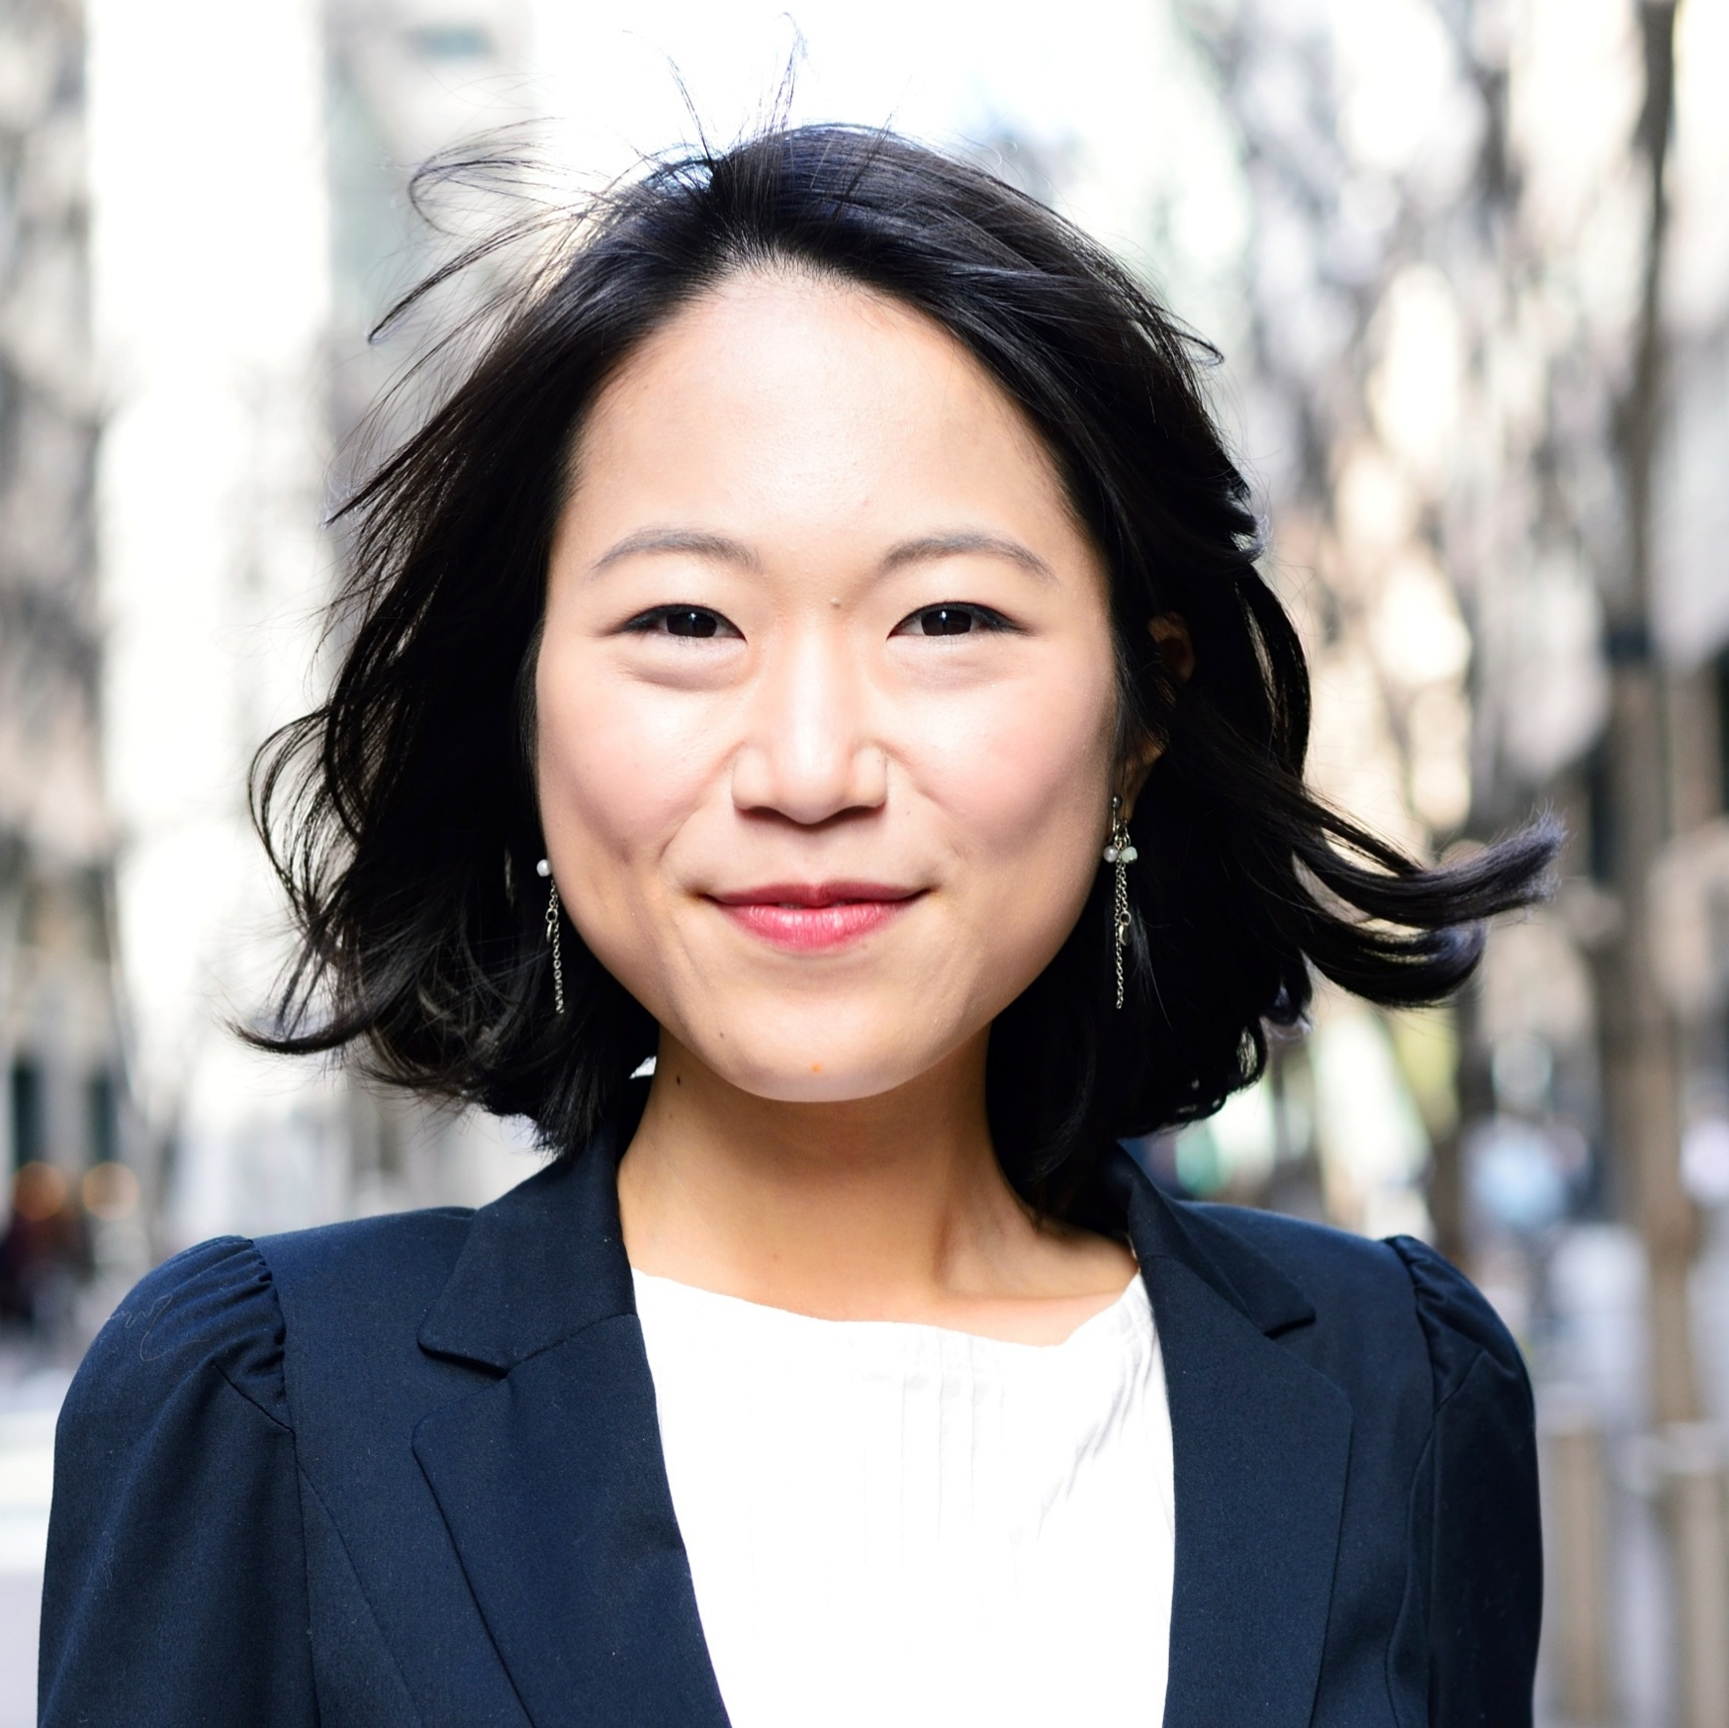




MEET THE TEAM
Notes:
Insert Board Member Photos/Coaching Team Members, split into two slides/change and adjust as needed.
Introduce individuals and share a little bit about each person and their background/credentials/area of responsibility or expertise.
Suggested topics to highlight:
Overview on board structure and importance of diversity of voice and helping shape the future of the program
How to express interest in joining the board or helping out on smaller committees
Benefits of working with accredited Skate Canada coaches (noting years of experience, professional development, skating background and achievements)

Slide 4
CLUB OPERATIONS
Policies:
  Skate Canada Policies
  Club / Skating School Policies
  Skate Canada Membership and Fees
Volunteer Opportunities
Resources:
  Parent Handbook/Club Resources
  Safe Sport
Notes:
Policies:
Skate Canada has a number of national policies in place that clubs and skating schools must be in compliance with. These policies promote consistency and operational efficiency and ensuring members have a safe skating experience. For example, there’s the Concussion Management Policy, Skate Canada Code of Ethics and Coach Accreditation policy to name a few.
Highlight club level policies and where they can be found (for example: volunteering, fundraising policies)
Volunteer Opportunities
Volunteering is a core component to building a supportive community for skaters and families. There are many fun and easy ways to get involved including:
[List and Highlight Important Roles, any volunteer commitments, program assisting opportunities]. Direct members where to find any relevant policies/resources and who to contact with questions.
Volunteers are covered by the general liability insurance and Skate Canada injury benefit.
Skate Canada Membership and Fees:
Annually skaters are required to purchase a Skate Canada membership. In addition to insurance coverage there are other perks of having a Skate Canada Membership including:
Access to qualified instruction
Access to competition events, both in competitive and non-competitive streams
Ability to complete nationally standardized testing and opportunities to advance
Pre-sale and discounted tickets to major Skate Canada events and special pricing on the online Skate Canada store
Exclusive access to resources through the Members Only section of the Skate Canada website
Coaching (may want a member of the coaching team to speak to these points)
How private and semi-private lessons work in StarSkate
Importance of consistent training and coaching
Lesson billing process and where to go with questions regarding scheduling/billing
Resources
- Highlight any club resources (such as a parent handbook) that members should be aware of

Slide 5
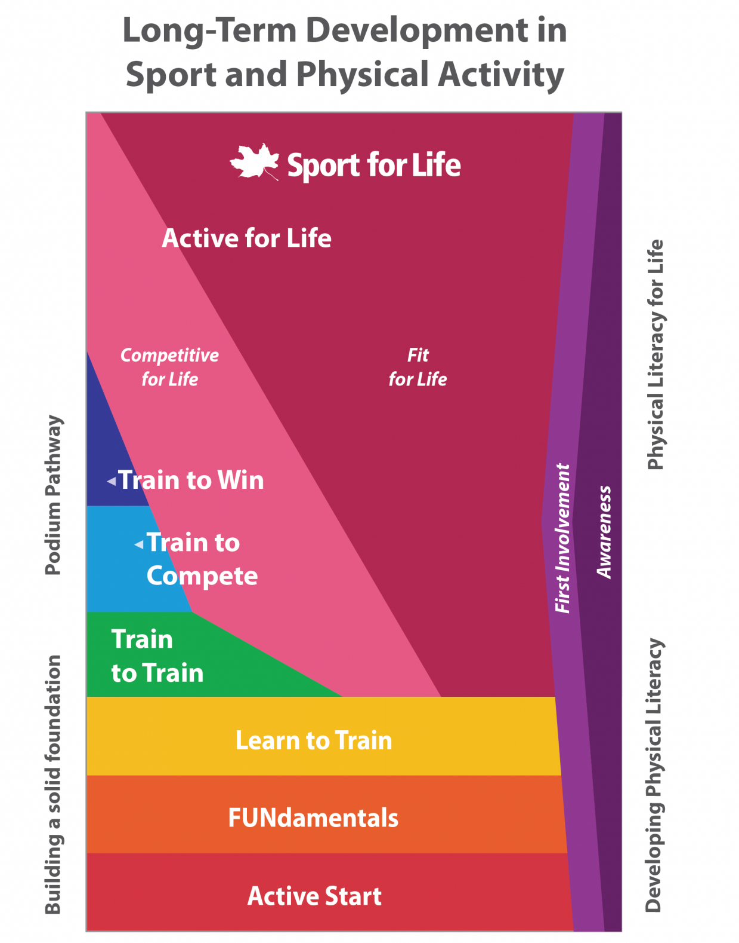
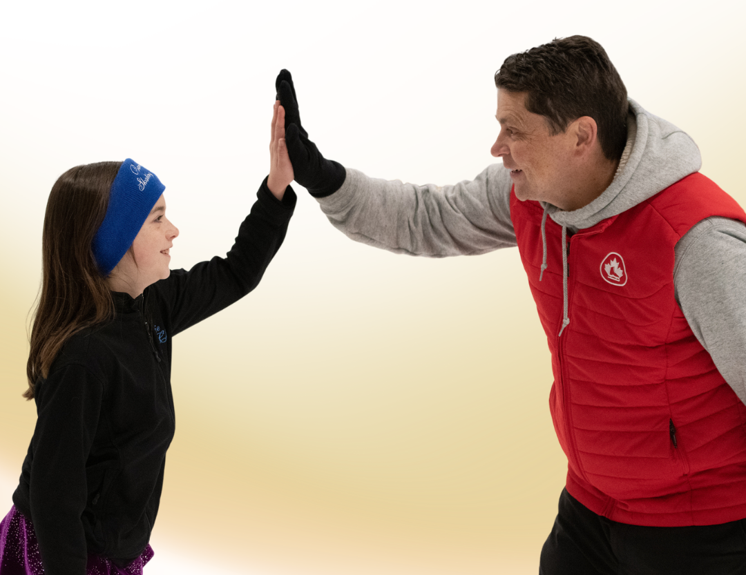
Long-Term Development
Notes:
In order to support skater progression, it's important to understand the foundation that guides everything we do at Skate Canada—the Long-Term Development, or LTD, framework.
The LTD framework is an athlete-centered and evidence-based approach to development. Rather than focusing only on short-term results or competition outcomes, it considers the whole athlete and supports physical literacy, personal growth, and lifelong participation in physical activity.
A key principle of LTD is recognizing that athletes develop at different rates. Age alone does not determine readiness for progression. Two skaters of the same age may be at very different developmental stages physically, emotionally, and technically. As a result, training, coaching, and advancement decisions are based on individual readiness and development rather than simply time spent in a program.
Another important concept is 'Active for Life.' While Skate Canada supports athletes pursuing competitive excellence and high-performance goals, the framework also emphasizes creating positive experiences that encourage lifelong participation in skating and physical activity. Whether a skater's goal is recreational enjoyment, personal achievement, coaching, officiating, or reaching the national podium, every pathway has value.
The LTD framework is also closely aligned with Canada's National Coaching Certification Program, or NCCP. This ensures that coaches receive training specific to the developmental stage they're teaching, allowing athletes to receive age-appropriate instruction and support throughout their skating journey.
Ultimately, the LTD framework helps ensure that every skater, whether recreational, StarSkate, or podium pathway, has an appropriate pathway to learn, develop, and enjoy the sport for years to come.
There is an excellent Parent/Guardian Education LTD Resource Guide located on the Skate Canada website for your reference.

Slide 6
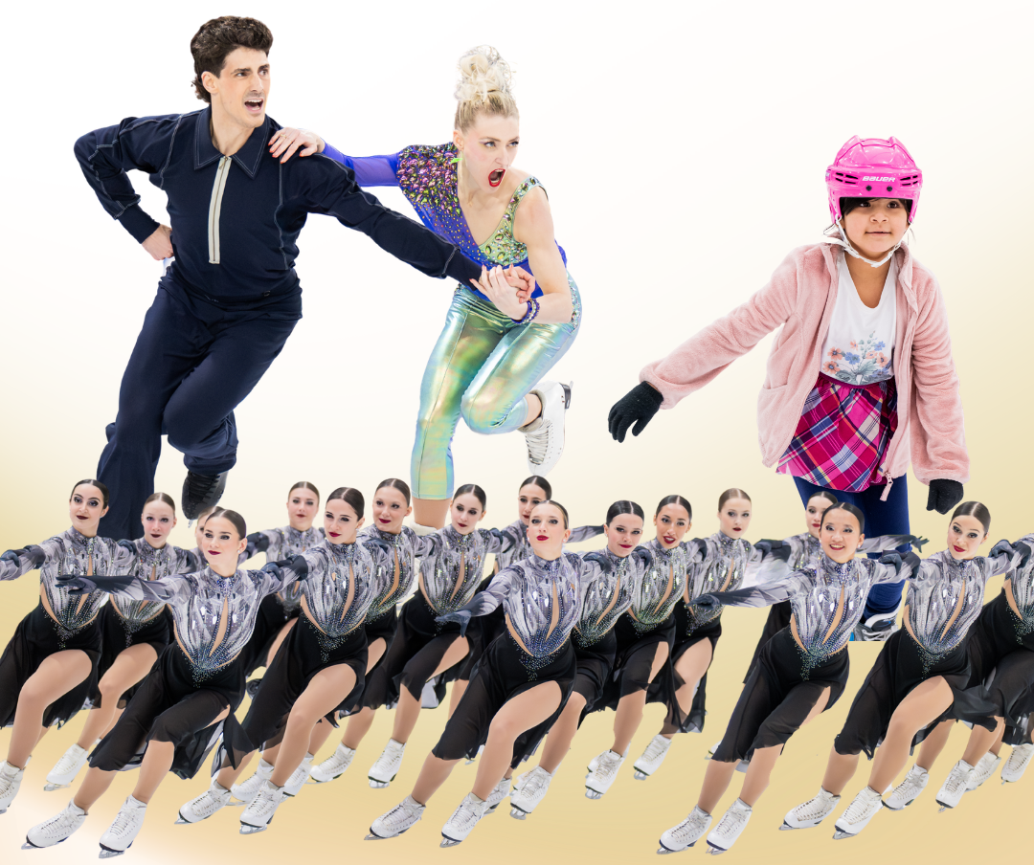
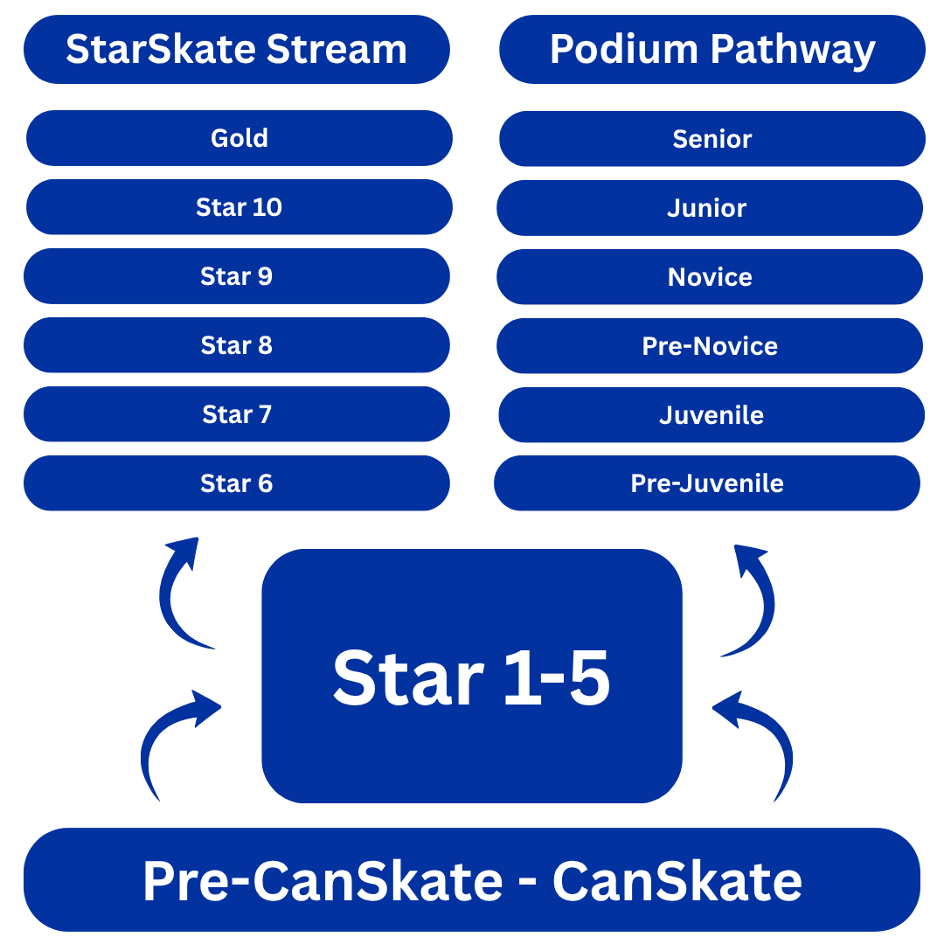
SKATER PATHWAYS
Notes:
Now we would like to walk through the Skate Canada development pathway and help families understand how skaters typically progress from their first steps on the ice through either the STARSkate stream or the Podium Pathway competitive stream.
It is important to remember that every skater's journey is unique. Progression depends on many factors, including athletic ability, motivation, attendance, work ethic, and personal goals. Our goal is to support each skater in reaching their full potential while ensuring they develop strong fundamental skills along the way.
CanSkate is the starting point for most skaters. During this stage, the focus is on developing strong fundamental skating skills.
The fundamentals learned here are critical. Before moving into the StarSkate pathway, skaters need a solid foundation in balance, control, turning, stopping, and overall skating confidence. Strong basics lead to greater success as skills become more complex later in their skating journey.
Typically once skaters reach CanSkate Stage 4 or above and demonstrates the maturity and readiness, coaches will transition them into StarSkate.
Once in STARSkate, skaters begin working within Skate Canada's comprehensive figure skating program.
Skaters develop skills in multiple disciplines including FreeSkate, Skating Skills, Ice Dance, and eventually Artistic skating and have the option to participate in synchronized skating. They work with professional Skate Canada coaches to support their overall development.
As skaters progress, they work toward standardized Skate Canada assessments and participate in competitions that align with their skill level and goals. Once skaters are in StarSkate, they can also choose to compete in the StarSkate stream (considered non-competitive) and the Podium Pathway stream (competitive.)
The StarSkate stream is ideal for skaters who wish to continue developing their figure skating skills while pursuing assessments, performances, and competitions.
This pathway allows skaters to set personal goals and participate at a level that matches their interests and aspirations. Success in StarSkate can look very different from skater to skater, and there are many opportunities to stay involved in the sport for years.
Podium Pathway is designed for skaters demonstrating the skill, commitment, and desire to pursue higher levels of competitive figure skating including national and international opportunities.
These skaters typically train more frequently, work toward increasingly challenging technical standards, and compete in qualifying and competitive events. The pathway supports long-term athlete development and provides opportunities for progression through regional, provincial, sectional, and national competitive levels.
Both pathways provide excellent opportunities for growth and development including standardized Star assessments which is a way of measuring a skater's progress and skill development. Skaters can complete assessments progressively from Star 1 - Gold in:
Skating Skills – edge quality, turns, power, flow, and skating technique
Ice Dance – pattern dances and dance elements
FreeSkate – jumps, spins, step sequences, and performance of programs
Artistic – creativity, interpretation, presentation, and performance
Assessments provide:
Clear development goals
Recognition of achievement
Benchmarks for future training
Motivation and confidence as skaters progress
Neither pathway is 'better' than the other - they simply serve different goals. Some skaters enjoy pursuing assessments and competitions at their own pace within StarSkate, while others thrive in the more demanding competitive environment of the Podium Pathway.
Coaches work closely with families to help determine the path that best aligns with a skater's abilities, commitment level, and aspirations. It is very important for families to remember is that every skater's journey looks different. Progression timelines vary significantly based on natural athletic ability, motivation, work ethic, practice habits, attendance, and individual goals. Some skaters advance quickly, while others benefit from spending more time mastering skills before moving forward.
Success should be measured by individual growth, confidence, and enjoyment of the sport rather than by comparison to others.

Slide 7
Questions & Discussion
[CLUB CONTACT/WEBSITE]
Notes:
As we wrap up today, I'd like to leave you with one important message: the foundation for skating success is truly built on community.
Whether a skater's goal is to learn basic skating skills, complete STAR assessments, perform in an ice show, or pursue high-performance competition through the Podium Pathway, none of it happens alone.
It takes a village of dedicated coaches, program assistants, volunteers, board members, officials, and supportive families working together to create opportunities for our skaters to learn, grow, and succeed.
Every early morning session, competition, assessment day, fundraiser, club event, and personal achievement is made possible by people contributing their time, expertise, and encouragement.
We encourage you to stay engaged, ask questions, and communicate with our coaching team and club leadership. We are here to help guide you through the various programs, pathways, assessments, and opportunities available to your skater. And don’t be afraid to get involved – sometimes that’s the best way to learn about this sport and help contribute your perspective and expertise to the club and broader skating community.
If you ever have questions about progression, STARSkate, the Podium Pathway, lessons, competitions, assessments, or what might be the best next step for your skater, please don't hesitate to reach out.
Thank you for being part of our skating community! We are happy to answer any of your questions at this time or you can contact the club at [list club contact information.]

